Slide 1
DSAI Final Project Presentation -
Predict Future Sales

Slide 2
Introduction

Slide 3

Competition Introduction
In this competition you will work with a challenging time-series dataset consisting of daily sales data, kindly provided by one of the largest Russian software firms - 1C Company.
Predict total sales for every product and store in the next month. By solving this competition you will be able to apply and enhance your data science skills.
https://www.kaggle.com/competitions/competitive-data-science-predict-future-sales/
Notes:
俄羅斯的公司 - 1C Company 所提供，由每日銷售資料組成具有時間序列的資料集。
要求參賽者預測未來一個月商品的銷售量。

Slide 4
Dataset Introduction
You are provided with daily historical sales data. The task is to forecast the total amount of products sold in every shop for the test set. Note that the list of shops and products slightly changes every month. Creating a robust model that can handle such situations is part of the challenge.
sales_train.csv - the training set. Daily historical data from January 2013 to October 2015.
test.csv - the test set. You need to forecast the sales for these shops and products for November 2015.
sample_submission.csv - a sample submission file in the correct format.
items.csv - supplemental information about the items/products.
item_categories.csv - supplemental information about the items categories.
shops.csv - supplemental information about the shops.
Notes:
提供每日歷史銷售資料，任務是為測試資料集預測每個商店的銷售量。
需要注意的是，商店和產品列表每個月都會略有變化。
它是真實的資料集，訓練樣本數目龐大，但是特徵欄位很少。
sales_train.csv - 2013/1~2015/10 的每日歷史資料。
test.csv - 測試資料集。需要預測這些商店和商品在 2015/11 的銷售額。
sample_submission.csv - 提交文件範例。
items.csv - 商品的補充訊息。
item_categories.csv - 類別的補充訊息。
shop.csv - 商店的補充訊息。

Slide 5
Observation

Slide 6
Dataset
Train Dataset
21807 items
60 shops
total : 2935849
Test Dataset
5100 items
42 shops
total : 214200

Slide 7
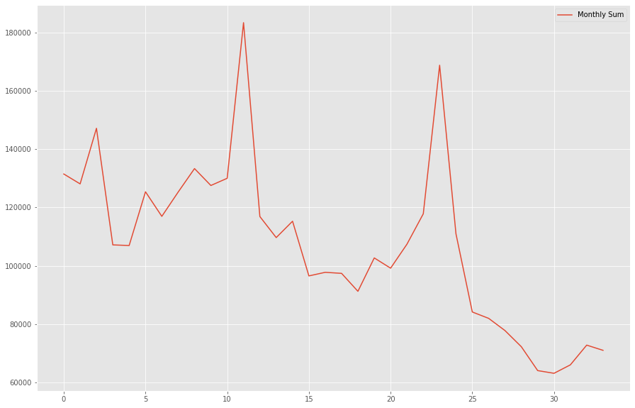
Observation
分析 33 個月商品的總銷售量
銷售量在最後幾個月有下滑的趨勢
高峰期大約落在每年的11月左右
分析最近 6 個月內狀況
商品停售
商店倒閉
商品價格對銷量的影響
商店所在城市對銷量的影響

Slide 8
Idea Description

Slide 9
Idea Description
Step 1. 資料觀察與分析
Step 2. 資料前處理
Step 3. 模型訓練
LSTM
XGBoost
Random Forest

